Slide 1
Recommendation system
Deep learning approach

Slide 2
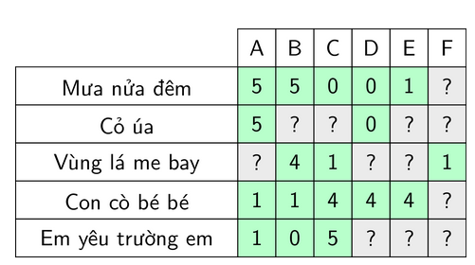
"Shallow" approach
Utility matrix
matrix with user, item and rating of user to item

Slide 3
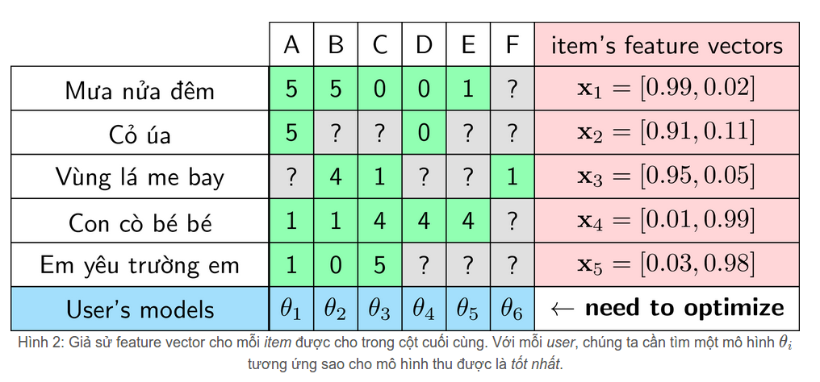
"Shallow" approach 1. Content-Based Recommendations
Recommend based on item property
Pre caculated
SGD
Derivative

Slide 4
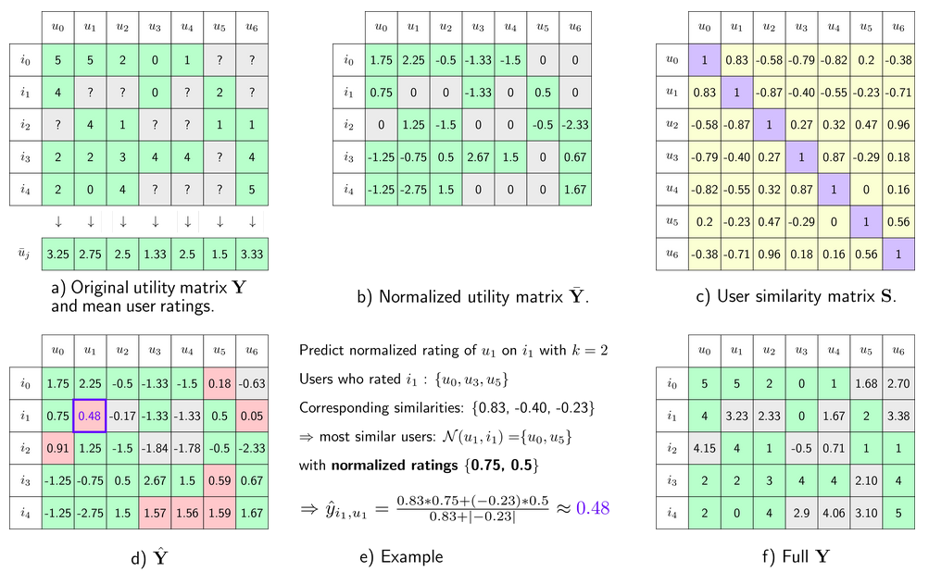
"Shallow" approach 2. User-user, item-item Collaborative Filtering
Recommend based on similarity of user or item
Need predict missing value
to fill utility matrix

Slide 5
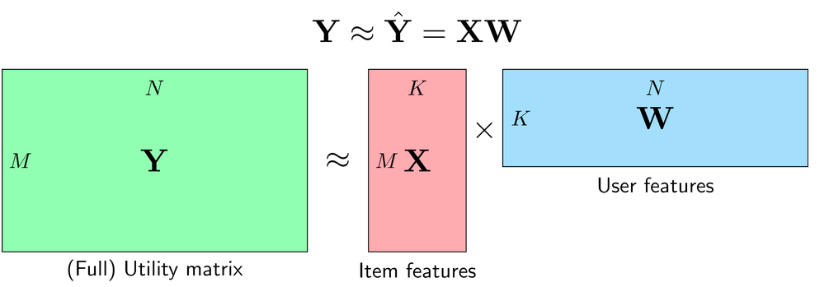
"Shallow" approach 3. Matrix Factorization Collaborative Filtering
Utility matrix ≈ item maxtrix * user matrix (two low rank maxtrix)
Need predict missing value to fill utility matrix

Slide 6
"Shallow" approach Why is it not accurate?
We need predict or caculate missing value in utility matrix to fill low rank matrix, ex:
Content-Based Recommendations: item feature vector.
User-user or item-item Collaborative Filtering: Normalized utility maxtrix.
Matrix Factorization Collaborative Filtering: full utility matrix.

Slide 7
Deeplearning approach
In deeplearning, we treat each unique value in categorycal variable with a unique id. Each unique id represent by a embedding vector with n dimension.
The same with item
User | Id | Embedding vector (5 dimension)
user A | 1 | 0,188 | 0,769 | 0,206 | 0,168 | 0,075
user B | 2 | 0,342 | 0,900 | 0,272 | 0,486 | 0,180
user C | 3 | 0,288 | 0,827 | 0,401 | 0,800 | 0,738
user D | 4 | 0,858 | 0,817 | 0,651 | 0,203 | 0,786
user E | 5 | 0,373 | 0,784 | 0,462 | 0,327 | 0,954
user F | 6 | 0,212 | 0,057 | 0,325 | 0,668 | 0,699
user G | 7 | 0,467 | 0,197 | 0,590 | 0,448 | 0,494

Slide 8
Deeplearning approach Example
User A rate item 1 with score = 7
0,188
0,342
0,288
0,858
0,373
0,212
0,467
User A -> User id = 1
-> look up to
embedding vector of user
Deeplearning model
predict score
0,206
0,272
0,401
0,651
0,462
0,325
0,590
Item 1 -> item id = 1
-> look up to
embedding vector of item
concat
Embedding vector

Slide 9
"Shallow" vs Deeplearning approach What's Different?
Deeplearning approach only use data of user already rate item to fit model!

Slide 10
Deeplearning approach How to caculate embedding vector?
backpropagation is the key!
Forward
Random number
0,188
0,342
0,288
0,858
0,373
0,212
0,467
User A -> User id = 1
-> look up to
embedding vector of user
Deeplearning model
predict score
Number optomized
0,206
0,272
0,401
0,651
0,462
0,325
0,590
Loss function
Backward

Slide 11
Deeplearning approach Very flexible!
Concat every categorycal, continous variable!
user property (age, city...), item property (year made, price...), economic value...
0,188
0,342
0,288
0,858
0,373
0,212
0,467
Flexible in output:
- multi output
- customize loss function.
User A -> User id = 1
-> look up to
embedding vector of user
Deeplearning model
predict score
0,206
0,272
0,401
0,651
0,462
0,325
0,590
Item 1 -> item id = 1
-> look up to
embedding vector of item
Flexible in DL network strucure: Feed forward net, Convolutional net, dropout layer, batchnorm layer....

Slide 12
Deeplearning approach One last thing. Session base recommendation
Recommend base on order of user action with sequence model.
Output
RNN
cell
RNN
cell
RNN
cell
...
RNN
cell
Action 1
Action 2
Action 3
Action n
Sequence model

